Slide 1

Intro to programming 1
Kamil Ševeček

Slide 2
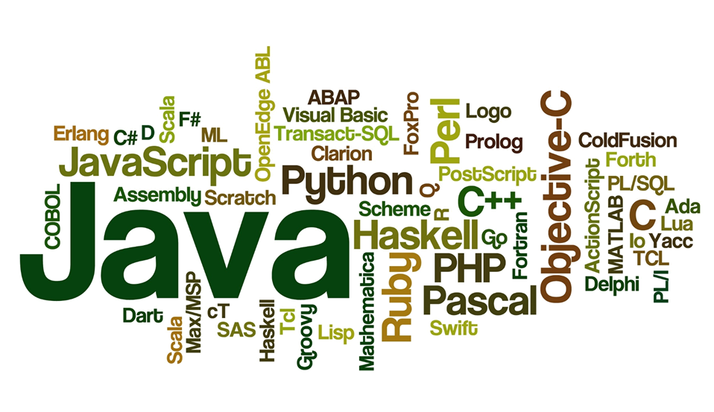
Programming languages

Slide 3
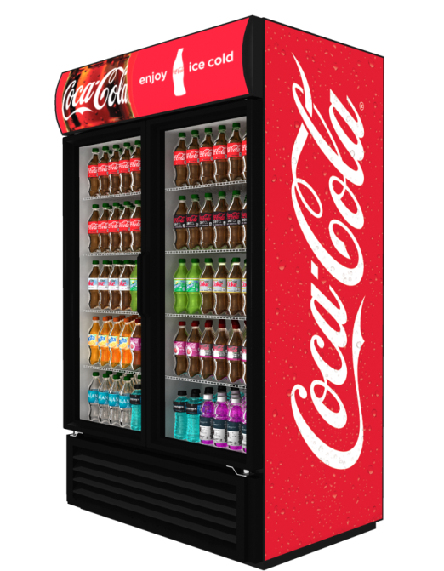
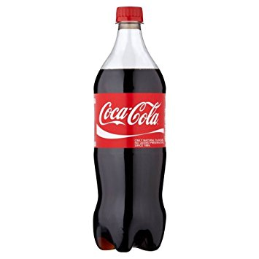
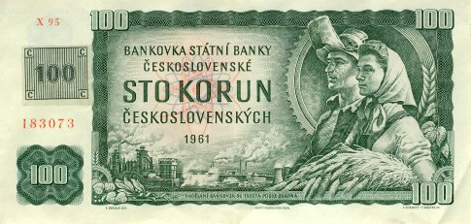
Functions
A function is an engine to transform an input to an output
funkce:

Slide 4



Functions
Calling functions from Java:
drink = automat(100);

Slide 5
Functions
A function is an engine to transform an input to an output
Math.cos(90);
Math.sin(3.141592);
Math.random();
Math.random() * 150;
System.out.println("Hi");
System.out.print("Hello");

Slide 6
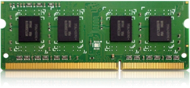
Variables and data types
variable
data type
int
myAge
5
variable name
value
..., 5, 0, 0, 0, ...
int myAge;
myAge = 5;
myAge = myAge + 1;
myAge = myAge * 2;

Slide 7
Variables
Some useful types:
int ............. integer number
double ....... number with a decimal point
String ....... text
boolean ..... true or false

Slide 8
Operators
Assignment:
=
Math operators:
+ - * /
Text concatenation:
+
Comparison:
> >= < <= == !=
Operators in conditions:
&& (a zároveň) || (nebo)

Slide 9
Exercise time!
Try your first programming steps!
Open file Exercises_variables.pdf
Go through assignments 1 to 6
Assignments 7 (BONUS) and 8 (BONUS) are here for the quicker ones only ;-)

Slide 10
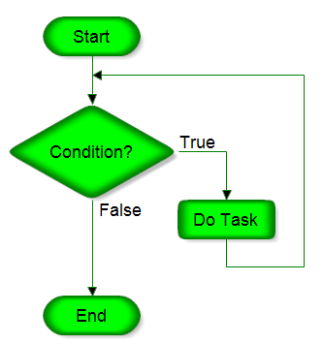
Loop (while)
while (condition) {
command();
command();
command();
}

Slide 11
Loop (while)
int count;
count = 0;
while (count < 5) {
System.out.print("*");
count = count + 1;
}

Slide 12
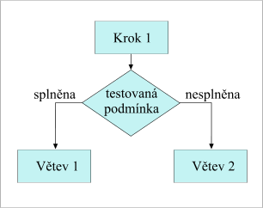
Conditional command (if)
if (condition) {
command();
command();
command();
}
if (condition) {
command();
command();
} else {
elseCommand();
}

Slide 13
Conditional command (if)
int chance;
System.out.println("It is 50:50 whether I greet you");
chance = Math.random();
if (chance > 0.5) {
System.out.println(" Hi :-) ");
}
int dice;
dice = (int) (Math.random() * 6 + 1);
if (dice == 6) {
System.out.println("Dice roll won 6");
} else {
System.out.println("Sorry, no 6, roll again");
}

